Slide 1


High Resolution Near-Field Spectroscopy and Manipulation of Single Molecules
Ilja Gerhardt – Gert Wrigge – Pavel Bushev Christian Hettich – Robert Pfab – Alois Renn Vahid Sandoghdar
Notes:
Welcome ladies and gentlemen
My name is Ilja Gerhardt and I come from the
Nano-Optics-Group in the
Swiss Federal Institute of Technology, Zurich
We are a part of the chemistry department and we are dealing with single molecules

Slide 2
Cryogenic studies: combination of spectral and spatial resolution
Narrow linewidth, lifetime limited
Addressing single quantum systems
High SNR
Extremely rare bleaching
Notes:
Single Molecule Spectroscopy -> Roomtemperature to cryogenics
Roomtemperature -> Broad spectrum
Lifetime limited linewidth

Slide 3
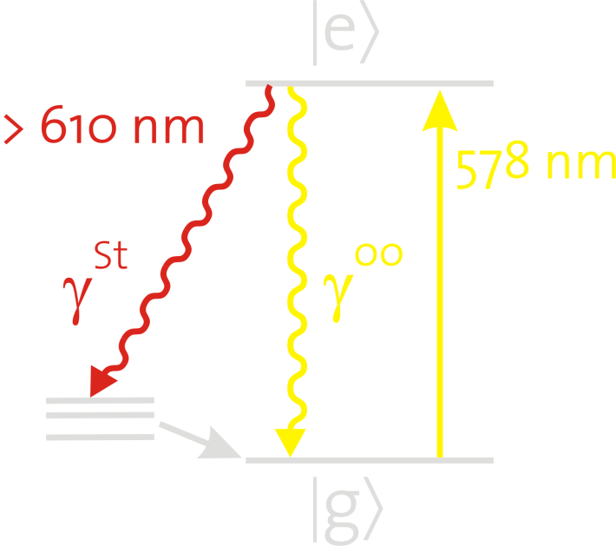
Our Sample
Thin films of p-terphenyl, doped with terrylene
Boehmer and Enderlein, J. Opt. Soc. Am. B, 20 (2003)
Easy fabrication
down to 20 nm thin sample
All molecules are close to the surface
Aligned molecules in z-direction
Fluorescence excitation
Wide field image, RT, Emission pattern
Pfab, Zimmermann, Hettich, Gerhardt, Renn and Sandoghdar, Chem. Phys. Lett., 387, 490 (2004)
Notes:
As many people in the SMS buiseness we are dealing with single organic molecules, embedded in an organic crystal
In the last years we developed a fabrication scheme, which is easy and has good results
If we now perform roomtemperature fluorescence imaging, we observe the following:
All molecules look like little doughnuts, which coresponds to an orientation in the z-direction

Slide 4

Set-Up
A cryogenic SNOM with confocal imaging option
Notes:
First: let’s understand the levelscheme
The Setup is coresponding
A narrowlinewidth dye laser
All the redshifted fluorescence is detected on an APD

Slide 5
Localizing Single Molecules in Inhomogeneous Electric Fields
Localization well below the diffraction limit
Localization accuracy
in all 3 dimensions
down to 2 nm
C. Hettich, C. Schmitt, J. Zitzmann, S. Kühn, I. Gerhardt & V. Sandoghdar,
Science 298, 385-389 (2002)
Notes:
If we apply an external electric field, for example from an outer electrode, the resonance line of a chosen molecule shifts due to the stark effect.
If we now move the electrode in respect to the sample – we are able to map the shift in relation to the position

Slide 6
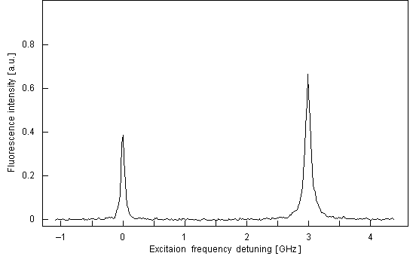
Dipole-Dipole Coupled Molecules
12 nm separation
C. Hettich, C. Schmitt, J. Zitzmann, S. Kühn, I. Gerhardt & V. Sandoghdar,
Science 298, 385-389 (2002)
Notes:
Now we were able to resolve two molecules, which were
Close in realspace
Close in frequency
We asked if it might be possible to couple these two molecules.
By increasing the power, a third resonance appeared in the middle

Slide 7
Sharp Tips
Near-field optics
Stark measurements
Confocal imaging
Betzig, Chichester, Science, 262, 1422 (1993)
Notes:
With this set-up it is now possible to perform a lot of experiments
Currently we are performing experiments with sharp apperture tips
And to remind you: at every pixel of our scan we get a lot of information:

Slide 8
Stark Effect Measurements
With sharp tips –
strong inhomogeneous E-field
Notes:
Performing experiments with sharp tips, we observe

Slide 9
Near Field Imaging of a Single Molecule at 1.4 K
Bethe, 1944
Bouwkamp, 1950
a=150nm, z-field
Notes:
Now we are able to perform even more experiments:
We are able to rasterscan over our sample at a temperature of 1.4 K
For years people have tried experiments with single molecules at low temperatures
Many attempts were not successful
We are now in the lucky situation to show you

Slide 10
Summary & Outlook
Working cryogenic SNOM
Combining scanning probe experiment & laser spectroscopy
Localizing molecules in electric fields
Investigation of coupled molecules
Strong Stark effect with sharp tips
Lateral scans / SNOM
→ Manipulating single quantum systems
Notes:
Let’s summarize what I have told so far:
I presented a SNOM, working at temperarures of 1.4 K

Slide 11
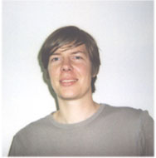

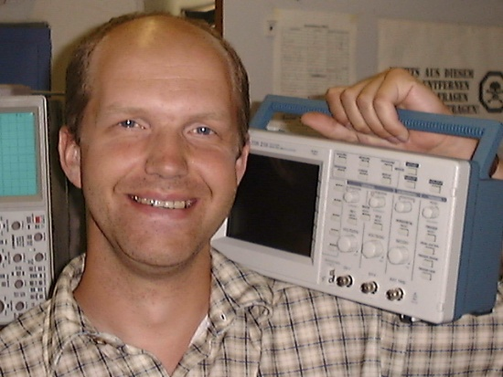
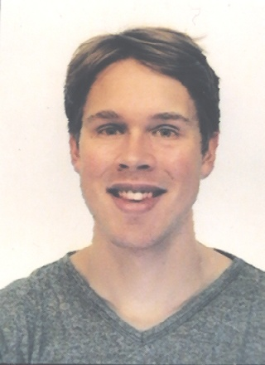
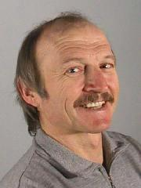
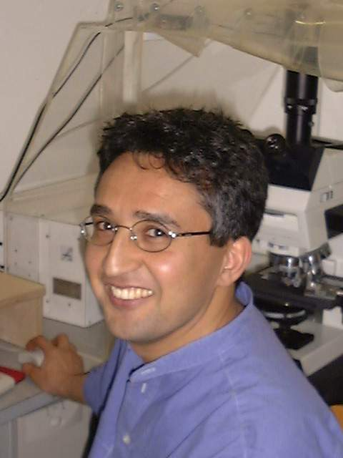
Acknowledgements
Gert Wrigge
Pavel Bushev
Christian Hettich
Robert Pfab
Alois Renn
Vahid Sandoghdar

