Slide 1
Scattering & Absorption of Light by a Single Molecule under a Subwavelength Aperture
strong interaction of matter and an ongoing light beam
direct measurement of light extinction by a single quantum system
Single molecule, embedded in a solid state matrix
SNOM: light source smaller than the classical cross-section

Slide 2
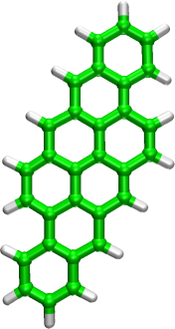
Single Molecules
T = 1.4 K
Dibenzanthanthrene = DBATT
in p-terphenyl

Slide 3
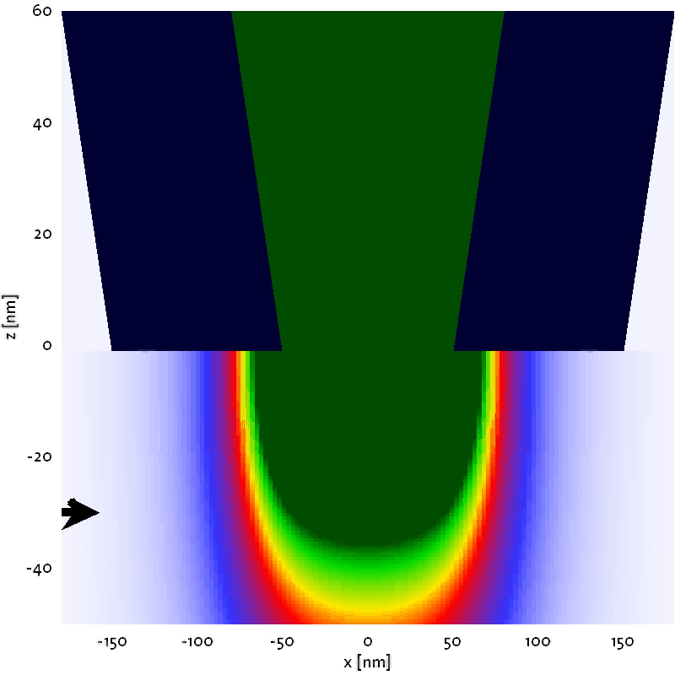
Near-field Optics
Near Field Optics:
z: exponential decay of E-Field
close approach to sample (<<l)
very thin sample necessary
Aperture resembles a radiating dipole in the far field

Slide 4
Set-Up

Slide 5
Transmission measurements
excitation of DBATT molecules through the tip, observed fluorescence
observed extinction, up to 6% visibility at 70nm tip-sample distance
xy, and tip-sample-distance dependence for fluorescence and extinction
Total recording time: 44 sec
I. Gerhardt et. al., quant-ph/0604177

Slide 6
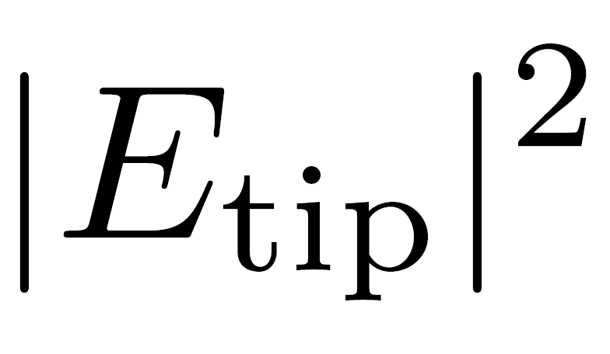
Distance dependence
z-distance

Slide 7
Summary
Near field optical studies at 1.4K
6 % attenuation of transmitted beam, directly measured, factor 10⁴ improvement
Studied the interferometric nature of extinction by
  a) changes in the near-field geometry (xyz)
  b) Analyzing the far-field components of the contributing fields
The work paves the way to a range of experiments
  Detection of emitters with a small Stokes shift
  Extinction measurements can be advantageous at small excitation intensities
  Access to coherent emission

Slide 8
Optical Detection of Single Molecules
a) Fluorescence excitation
Low background
Room temperature experiments possible
Routine tool for biological and chemical research
but coherent information lost
b) Detection in Transmission
Probing pure two level systems (atoms, QD, molecules)
Based on efficient light-matter interaction
Access to the coherent emission
}
a)
}
b)

