Slide 1
Coherent State Preparation of a Single Molecule
Ilja Gerhardt, Gert Wrigge, Jaesuk Hwang, Gert Zumofen, Alois Renn
& Vahid Sandoghdar

Slide 2

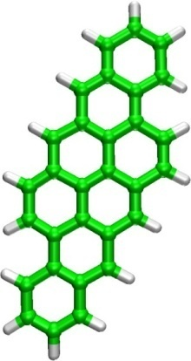
Single molecule spectroscopy
Dibenzantanthrene, DBATT
Embedded in organic matrices
e.g. Shpol’skii

Slide 3
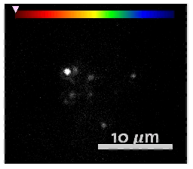
Fluorescence Excitation
Wide-field illumination
T=1.4 K
λ ~ 615 nm, 30 GHz scan

Slide 4
Lifetime Limited Linewidth…
Lifetime limited linewidth
T1~10ns

Slide 5
Efficient Excitation
FWHM=370nm
Solid Immersion Lens
Wrigge et al., Nature Physics 4, 60 - 66 (2008)

Slide 6
Single Molecule Extinction
Fluorescence detection
Extinction up to 11.5%
Mollow Triplet
Fluorescence
Extinction
Wrigge et al., Nature Physics 4, 60 - 66 (2008)

Slide 7
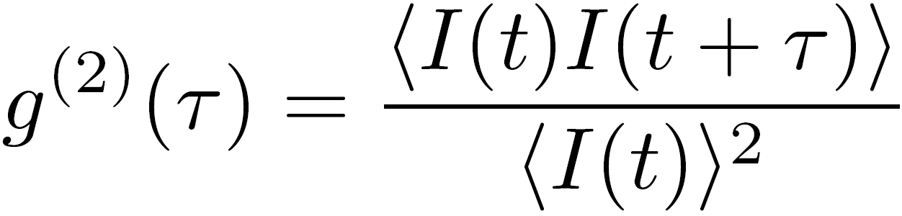
Photon statistics

Slide 8
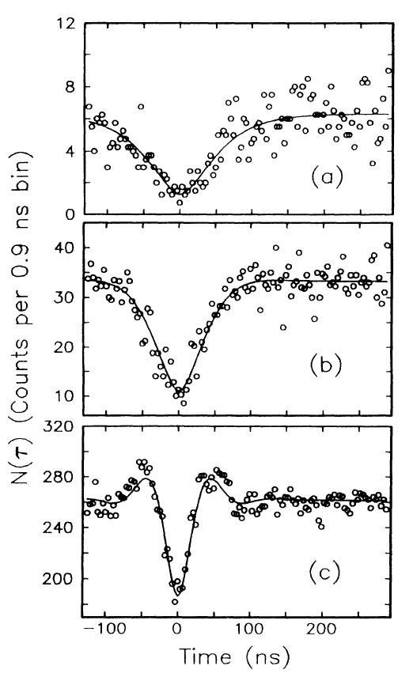
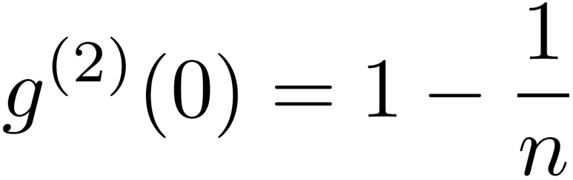
Photon statistics
Super Poissonian
Rabi-oscillations
T. Basché et al., Phys. Rev. Lett., 69, 1516 (1992)

Slide 9
Autocorrelation
Rabi-oscillations
  Short pulse?
  Single photons?
  Transmission
  Change?
  Phase gate?
Driving the molecule to a defined point of excitation
  It stays there for t=T1

Slide 10
Short Pulse Experiments
|e⟩
γ^{St}
γ⁰⁰
|g⟩
Driving the Bloch-vector to a defined point of excitation
detecting the red-shifted fluorescence (∝ ρ₂₂)

Slide 11
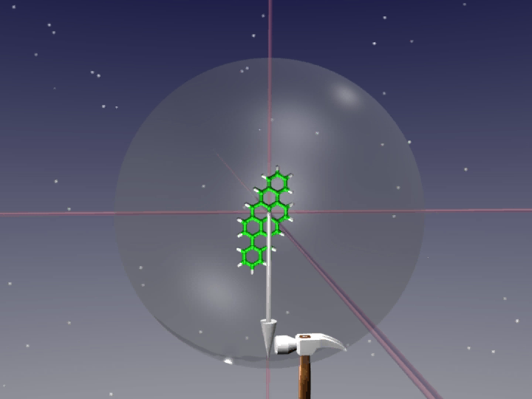
The Experiment
Rb: Gibbs; Molecules: Orlowski

Slide 12
Idea & Realization
Phys. Rev. A 79, 011402(R) (2009)

Slide 13
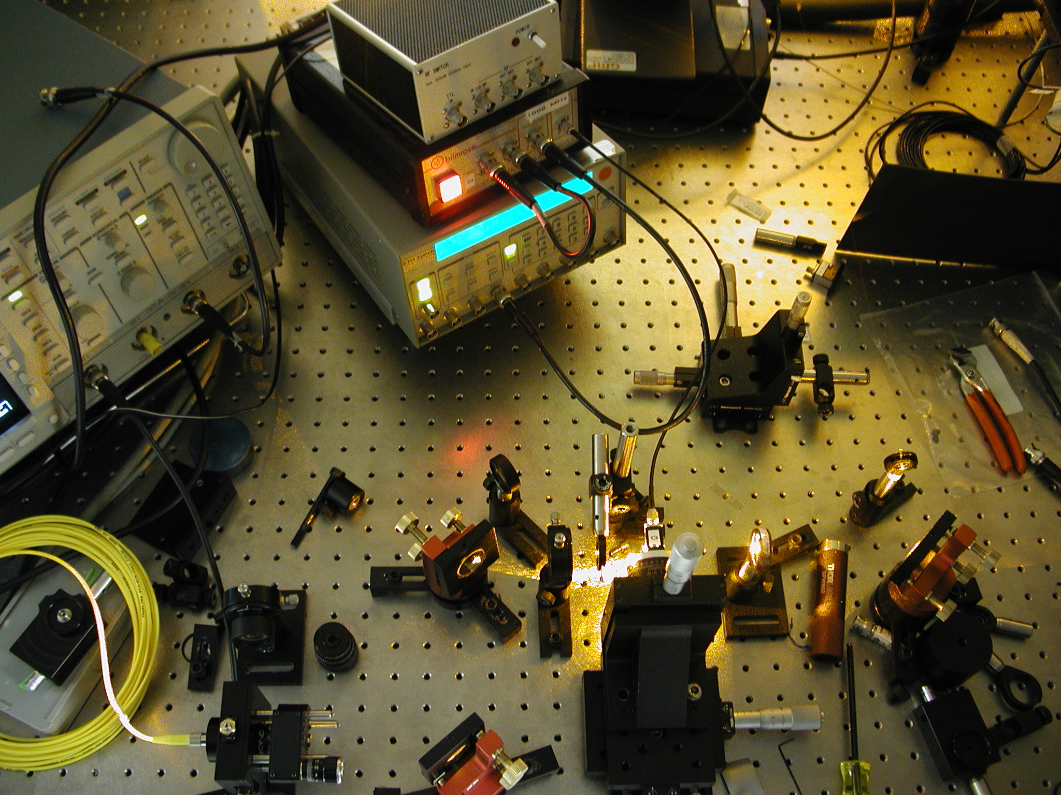

Slide 14
AOM
2.9 nsec possible (limit: AOM, focussing)
1 MHz Rep. rate (limit: Pulsegenerator DG535)
Problem: Peak vs. BG (limit: RF-Switching, scattering)
Phys. Rev. A 79, 011402(R) (2009)

Slide 15
Setup
Phys. Rev. A 79, 011402(R) (2009)

Slide 16
Time Evolution
Phys. Rev. A 79, 011402(R) (2009)

Slide 17
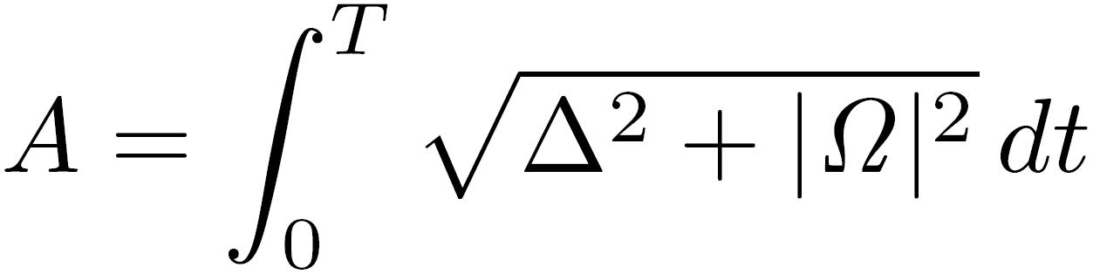
Integrated Mode
Also integrated experiments possible:
  Illuminate with short pulses
  Record Integrated red-shifted fluorescence
Phys. Rev. A 79, 011402(R) (2009)

Slide 18
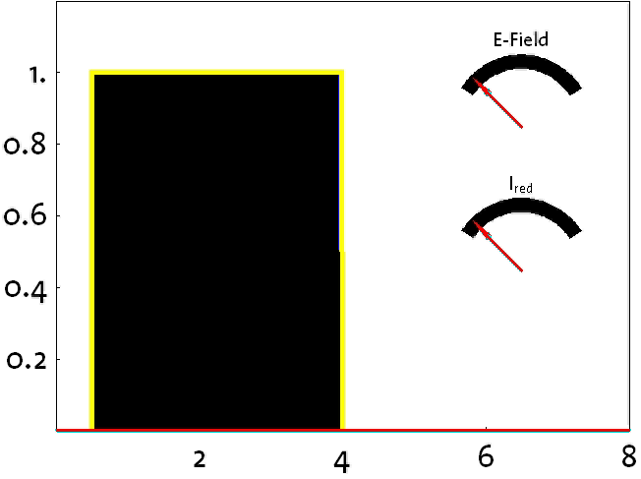
The Signal
Intensity [a.u.]
Background
Decay within pulse
Time [ns]
Phys. Rev. A 79, 011402(R) (2009)

Slide 19
Setup
Phys. Rev. A 79, 011402(R) (2009)

Slide 20
Integrated Photons
??
500 photons
per pulse
9π
7π
5π
10π
3π
8π
π
6π
4π
2π

Slide 21
Setup
Phys. Rev. A 79, 011402(R) (2009)

Slide 22

Detuning Dependence
Phys. Rev. A 79, 011402(R) (2009)

Slide 23
Frequency Dependence

Slide 24
Frequency Dependence
Phys. Rev. A 79, 011402(R) (2009)

Slide 25
Results & Summary
Short Pulse Experiments with a Single Molecule
  First measurements on a single molecule
Time resolved mode
  Similar to Autocorrelation, nice way to determine T1 and T2
Integrated mode
  Up to 10 π oscillations (max. in solid state)
  First detuning dependent data
First extinction measurements (not shown)
Aiming for coherent control – phase gate
(?)

Slide 26
What’s next?
Single Photon Source
  Detector efficiency
More Extinction
Imaging
Single Molecule Switch (2nd Laser)

Slide 27
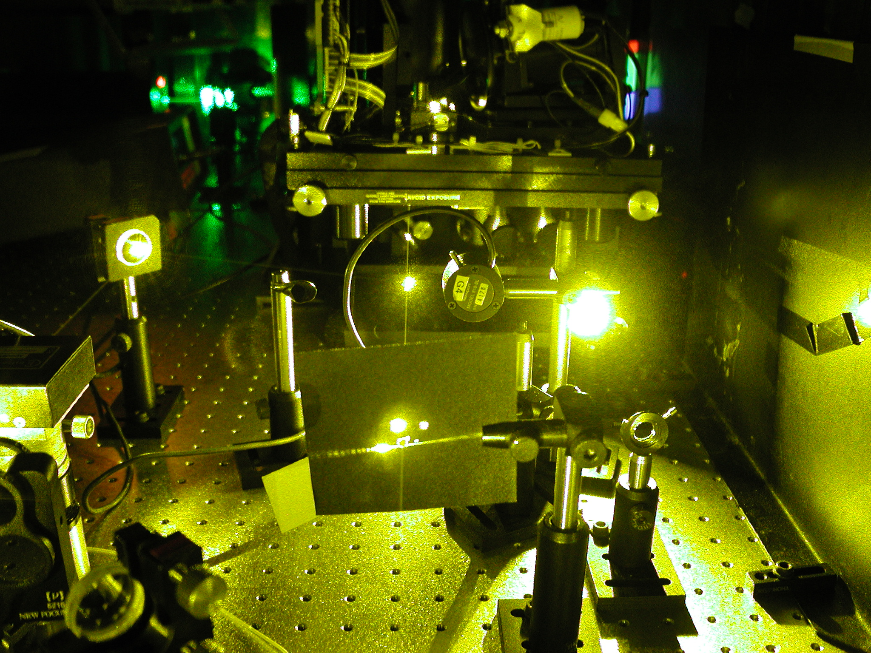
Thanks for Your Attention

