Slide 1




1
Lecture at the 26th Chaos Communication Congress, Berlin, December 27, 2009
How you can build an eavesdropper for a quantum cryptosystem
Vadim Makarov, Qin Liu, Ilja Gerhardt, Antía Lamas-Linares, Christian Kurtsiefer Sebastien Sauge, Andrei Anisimov
Joint project supported by an ECOC’2004 grant & the Research Council of Norway
www.iet.ntnu.no/groups/optics/qcr

Slide 2
Outline
2
Introduction to quantum cryptography
One quantum hacking strategy: intercept-resend attack
Avalanche photodiodes under bright illumination
Attack on a real QKD system and hardware demo
Hacking commercial detectors
Final remarks

Slide 3
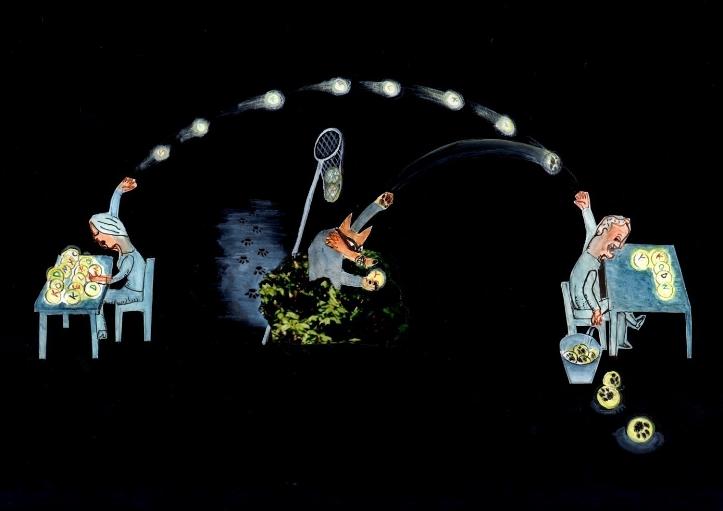
A brief quantum key distribution (QKD) primer
3
Alice
Eve
Bob

Slide 4
Do it quantum, baby!
4
1 single photon per bit (encoded on phase, polarization...)
”0” ↔ H ”1” ↔ V
Security based on a physical law:
observation causes perturbation ↔ you cannot copy an unknown quantum state Heisenberg uncertainty principle ↔ No-cloning theorem

Slide 5


Complementarity?
5
One cannot measure simultaneously...
position and momentum
polarization in H/V basis and +45⁰/-45⁰ basis
1
1
0
Incompatible (complementarity) bases
0
H
V
+45°
-45°

Slide 6
QKD protocol
Alice makes 2 random choices: key-bit value (0 or 1)
measurement basis (H/V or +45⁰/-45⁰)
Bob makes 1 random choice: measurement basis (complementarity).
Alice and Bob keep bits for which they have used same basis (→ same bit value)
In 50% of the cases, Eve makes wrong guess of measurement basis and is detected.

Slide 7
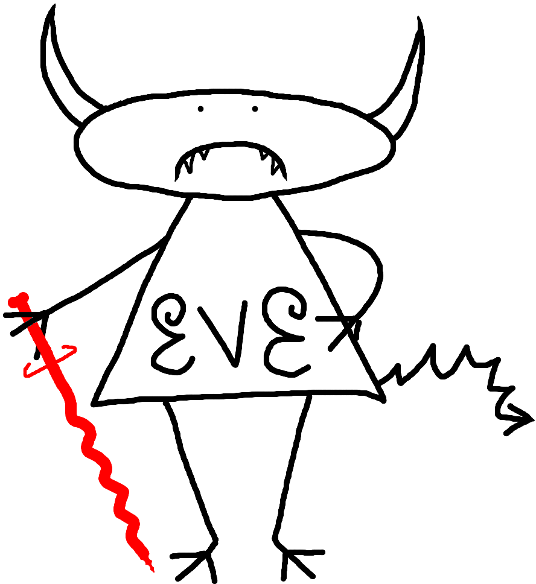
It’s a perfect world...
7
for hackers!
Quantum Key Distribution (QKD) is unconditionally secure
practically ?
Eve lost the battle against security proofs...
But she can exploit unaccounted imperfections of components (e.g. detectors)

Slide 8
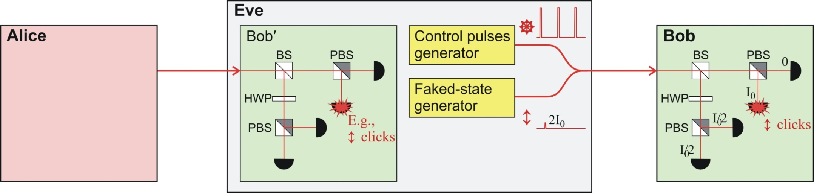
intercept-resend (faked-state) attack
8
Eve owns an exact replica of Bob’s detection apparatus
She intercepts and measures the qubits sent by Alice
She resends a faked-state to Bob
Faked.state generator
Pulsed? C.W.?
Control generator (blinding)
Faked state generator
Can Eve get the same detector to click at Bob’s side while keeping all 3 others blind?

Slide 9
intercept-resend (faked-state) attack
9
What if... detectors always click at intensity I₀ and never click at I₀ /2?
Target detector always click ü
In complementary basis, pulse is split in 2 halves of intensity I₀ /2 : no click ü
Faked.state generator
Pulsed? C.W.?
Control generator (blinding)
Faked state generator
Quantum cryptosystems using such detectors are vulnerable!
Are there many single-photon detectors working as in our ”what if” scenario?

Slide 10
10
OH YEAH!

Slide 11
Meet the SPAD : Single-Photons Avalanche Diodes
11
Currently, none of them is safe!
Available on the majority of quantum cryptosystems
Why →

Slide 12
12
The difference between ideal... and real (an example with a passively quenched Si APD)
1
E
+
6
d
1
E
+
5
n
o
c
1
E
+
4
e
s
1
E
+
3
r
e
p
1
E
+
2
s
Geiger mode (single-photon sensitivity)
t
n
1
E
+
1
u
o
C
1
E
+
0
1
E
-
1
1
E
-
2
1
E
-
1
6
1
E
-
1
5
1
E
-
1
4
1
E
-
1
3
1
E
-
1
2
1
E
-
1
1
1
E
-
1
0
1
E
-
9
1
E
-
8
O
p
t
i
c
a
l
p
o
w
e
r
a
t
t
h
e
A
P
D
,
W
Under bright illumination, SPAD becomes blind to single-photons...
How is that possible?

Slide 13

13
SPAD : a question of breakdown
I
BELOW breakdown (linear mode)
it’s a linear amplifier (Gain < 1000)
NO single-photon sensitivity
ABOVE breakdown (Geiger-mode)
it’s a trigger device (Gain “infinite”)
Single-photon sensitivity
ON
V_{breakdown}
OFF
V
Does bright illumination bring the SPAD to work in linear mode?
In this regime, could we still make the SPAD click controllably?

Slide 14
14
OH YEAH!

Slide 15
APD
15
390 k
Passively-quenched detector
BIAS voltage
Comparator
(I₀)
100
V
Single-photon response
V
Bright CW illumination
SPAD kept below breakdown voltage now works as a mere PAD! → SPAD is blind (”0”) to single photons
→ SPAD will click (”1”) if classical pulse above comparator threshold (I₀)

Slide 16
Now I am blind, now I click…
16
⇨
No click
50 μW
Bright CW illumination
keeps detector blinded
⇨
Single click
Faked state
4 mW
50 μW

Slide 17
The faked-state attack
17
Eve forces her detection result onto Bob by sending
- CW background light to keep all detectors blinded (circular polarization)
- Faked-state above threshold I₀ to make target detector click (linear polarization)
CW
Faked.state generator
Pulsed? C.W.?
Control generator (blinding)
Control generator (blinding)
Faked state generator
Faked state generator
In conjugate basis, faked-state is split in half, below threshold (no click)

Slide 18
18
Attack on a real QKD system

Slide 19
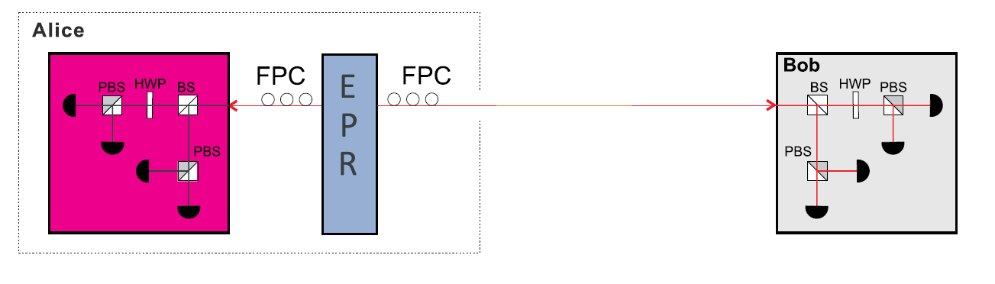

The EPR source: 2 entangled photons (1 to Alice, 1 to Bob)
19
The photon pair is in a well defined state, but each photon is in an undefined state.
One photon is always orthogonal to the other.

Slide 20
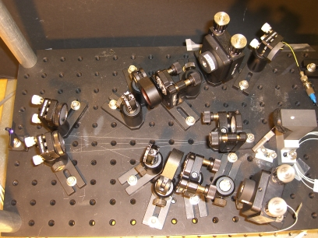
The EPR source: 2 entangled photons (1 to Alice, 1 to Bob)
20

Slide 21
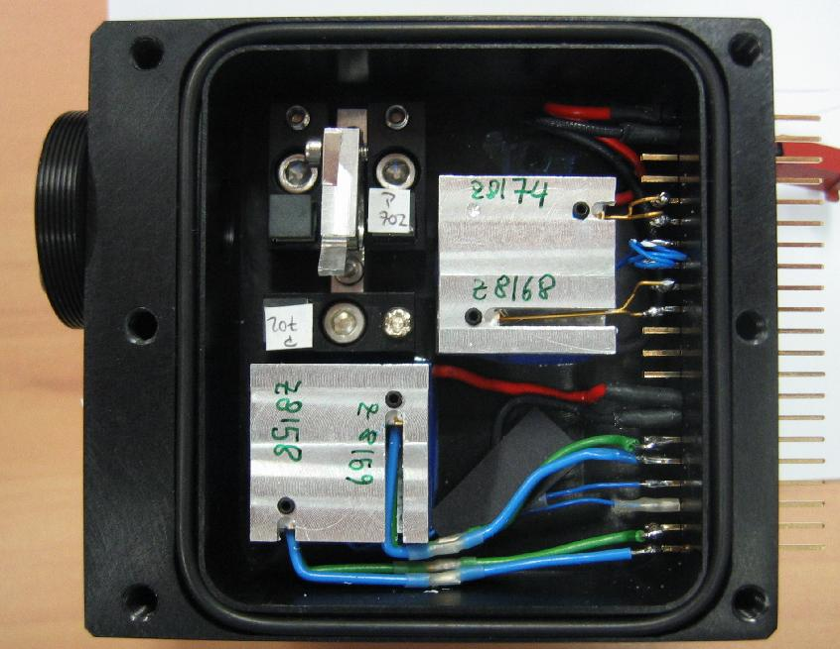
Alice and Bob’s detectors
21

Slide 22
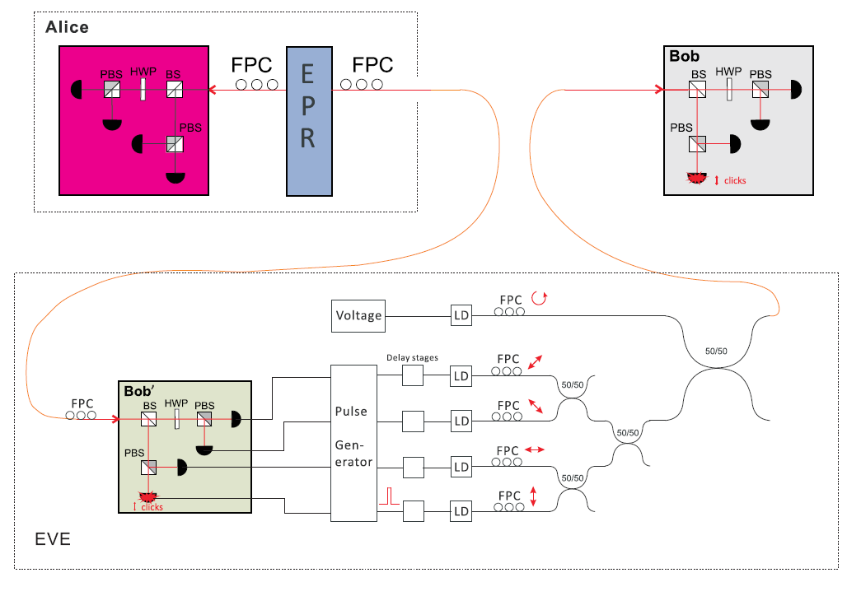
Normal QKD
22
QKD under attack

Slide 23
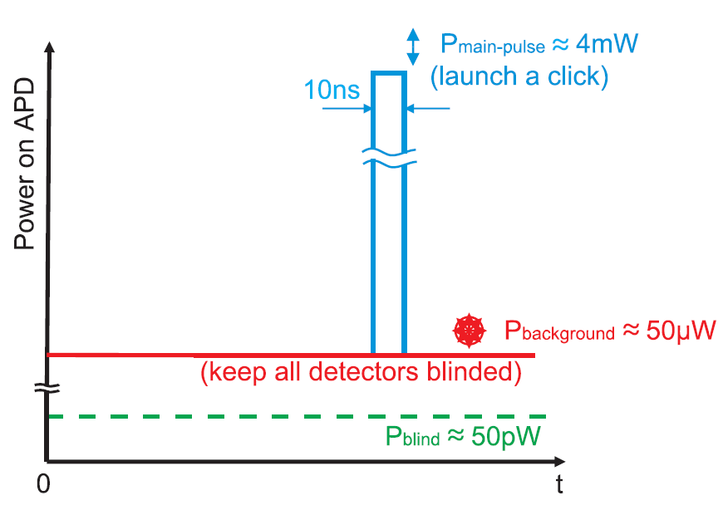
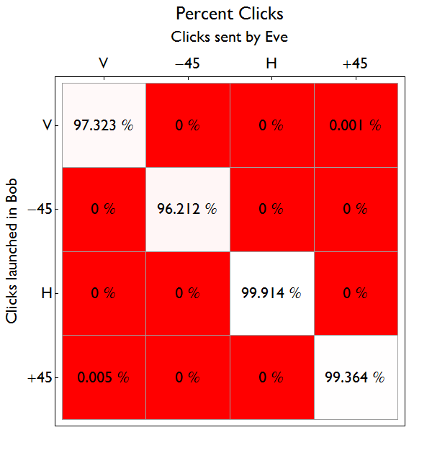
Controlling Bob’s 4 detectors nearly 100%
23

Slide 24
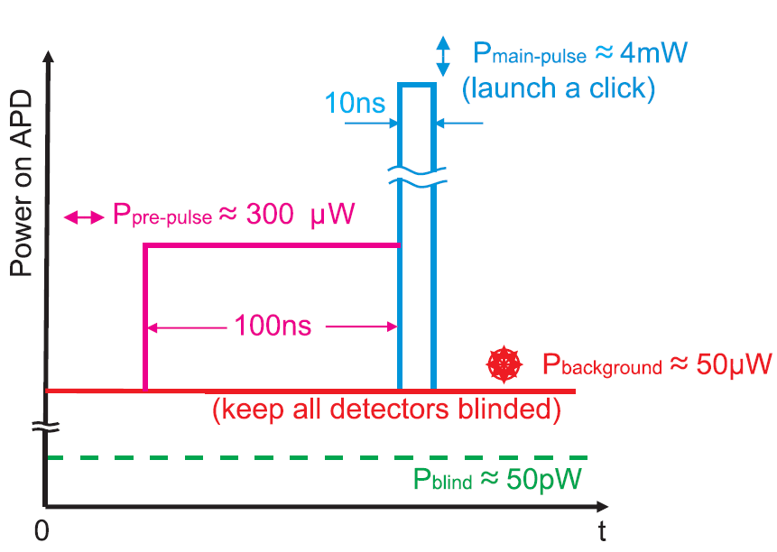
Controlling Bob’s 4 detectors nearly 100%
24
100%
0 %
100%
100%
0 %
100%

Slide 25
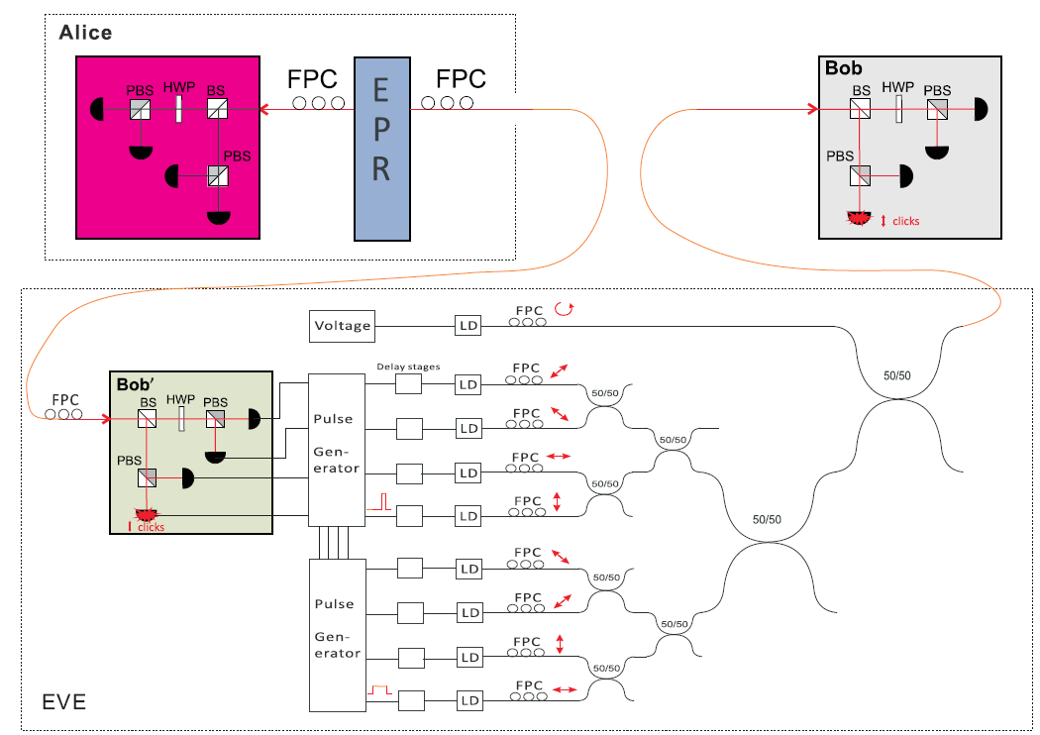
Eve’s final scheme
25

Slide 26
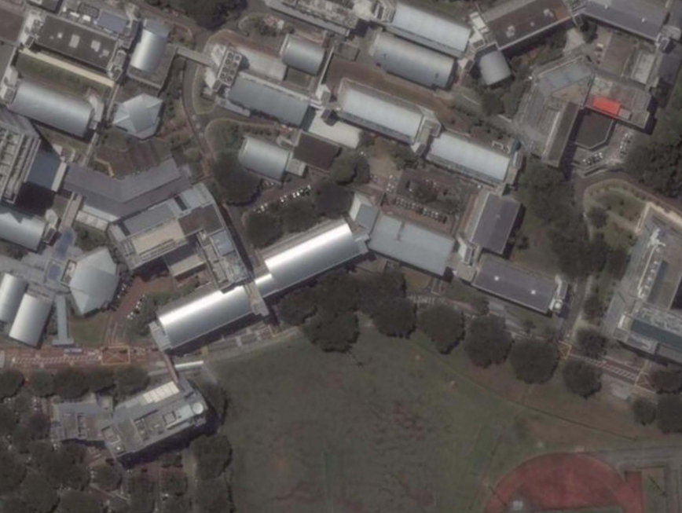
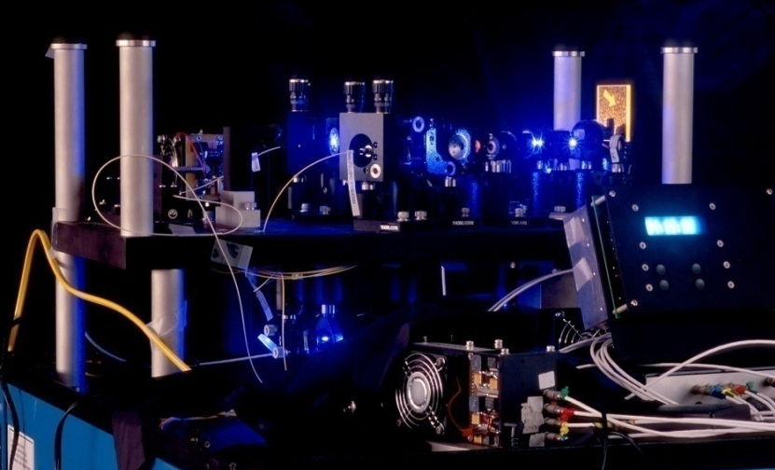
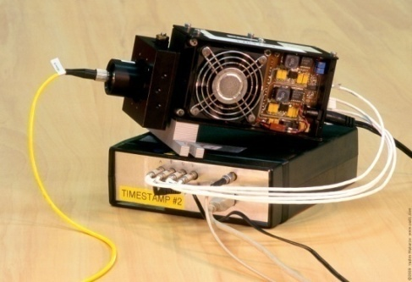
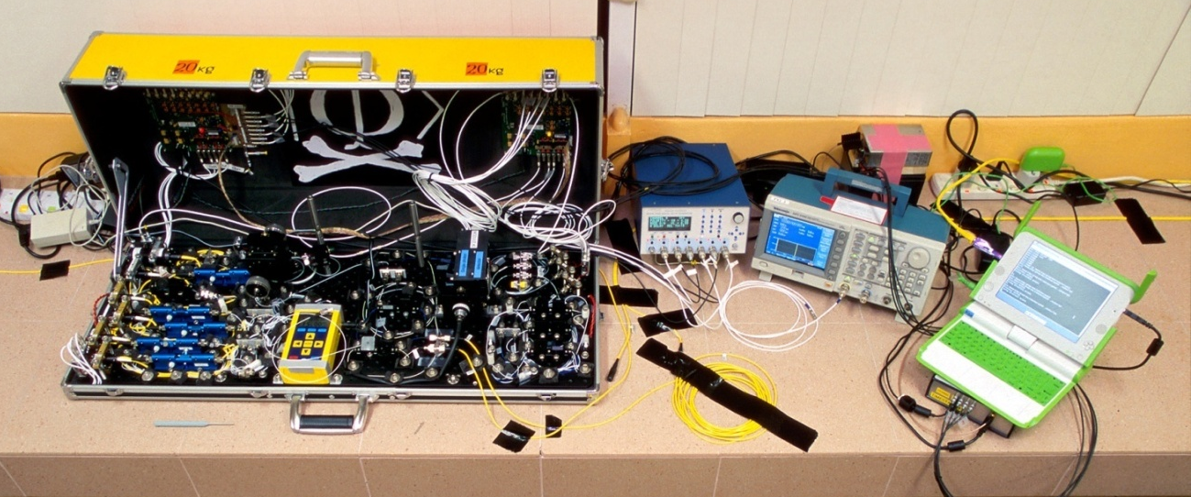
Eavesdropping on installed QKD line on campus of the National University of Singapore
26
290 m of fiber
Eve
S14
S13
Bob
Alice
S12
S15
Satellite image © Google

Slide 27
Does Eve really have 100% of the key?
Clicks in Eve:
Clicks in Eve and Bob:
Clicks in Bob:
ü
Good correlation
û
More clicks at Eve
Eve has 100% of the key because Bob has to reveal which clicks were received
doesn’t matter

Slide 28
Down by numbers
28
Raw key rate 25 k counts/s over 8 minutes
Eve sent to Bob : 12 780 101 bits
Bob received: 12 754 445 (99.8%)
Correlated: 12 754 439 (99.9998% correct bit value)
Extra clicks in Bob: 0
QBER kept at ≈ 6% < 11% limit setting alarm
No noticeable change after Eve’s interruption!
First implementation of an intercept-resend attack under realistic conditions!

Slide 29
Compare by plots
29
Before attack:
After attack:
Raw key
rate
(cps)
QBER
(%)
Time (s)
Time (s)

Slide 30
Demo is coming…
30
Full control over a single channel in the real detection unit used for Bob
⇨
No click
⇨
Single click
Faked state

Slide 31
31
How vulnerable are commercial detectors?

Slide 32
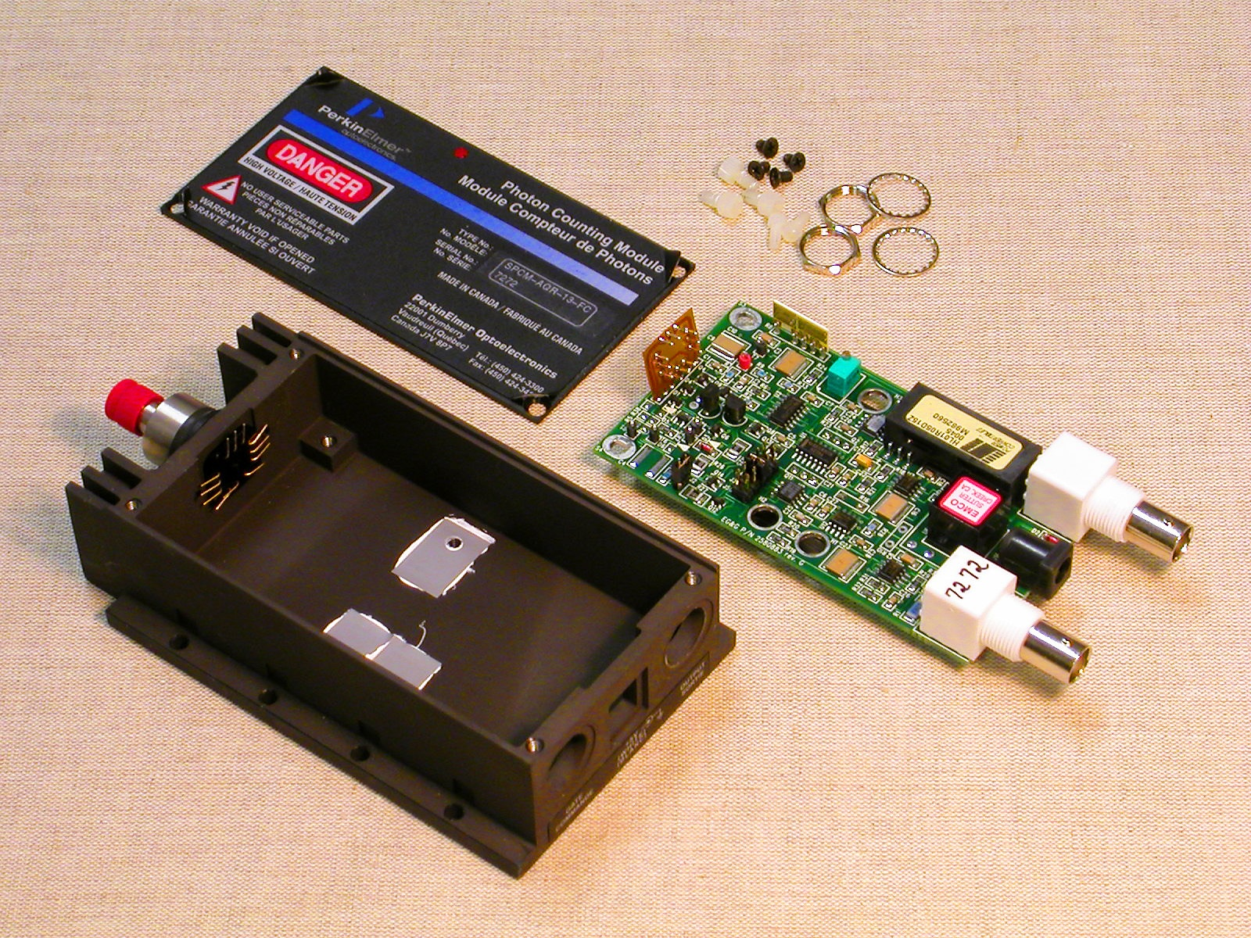
Illustration with an actively-quenched detector
32
Visible/infrared
PerkinElmer SPCM-AQR

Slide 33
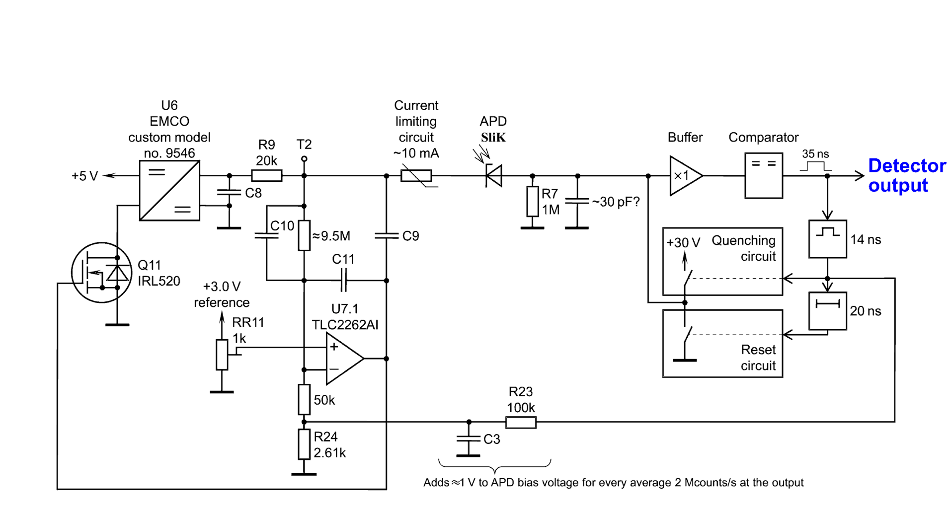
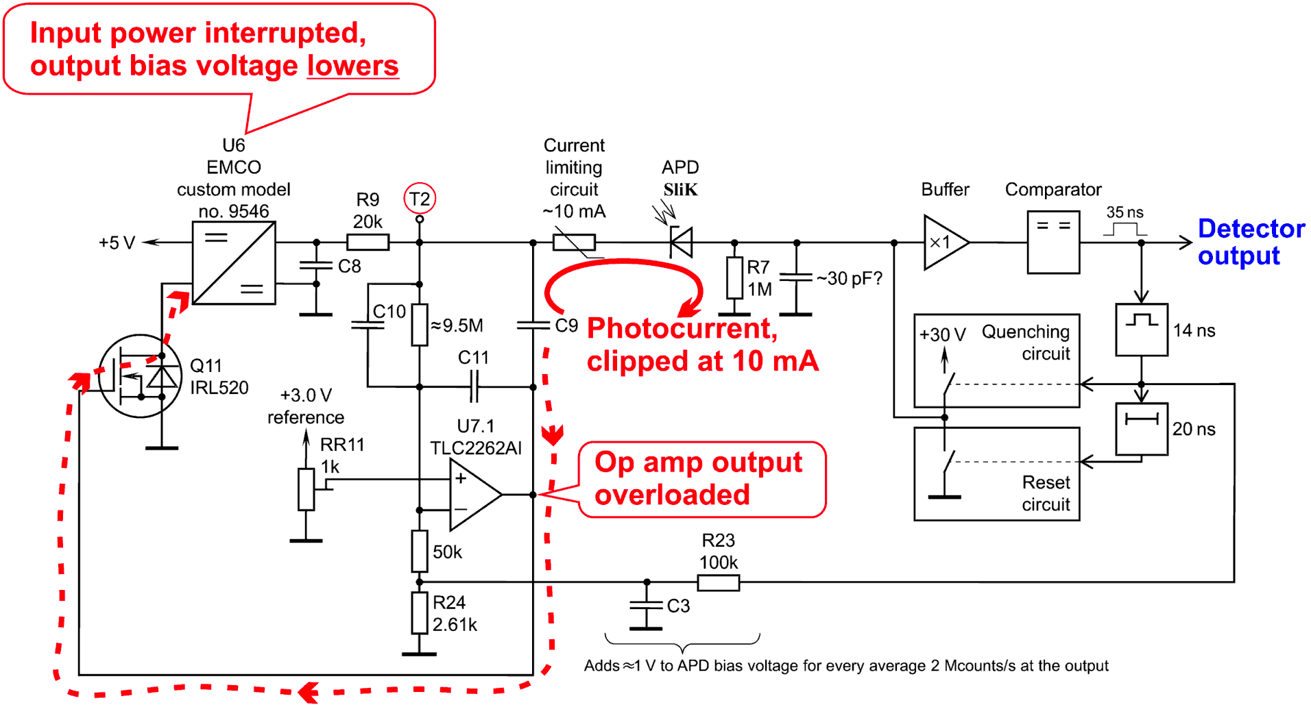
A bit of reverse-engineering...
33
Eve sends bright pulses (50 ns wide, >2 mW)

Slide 34
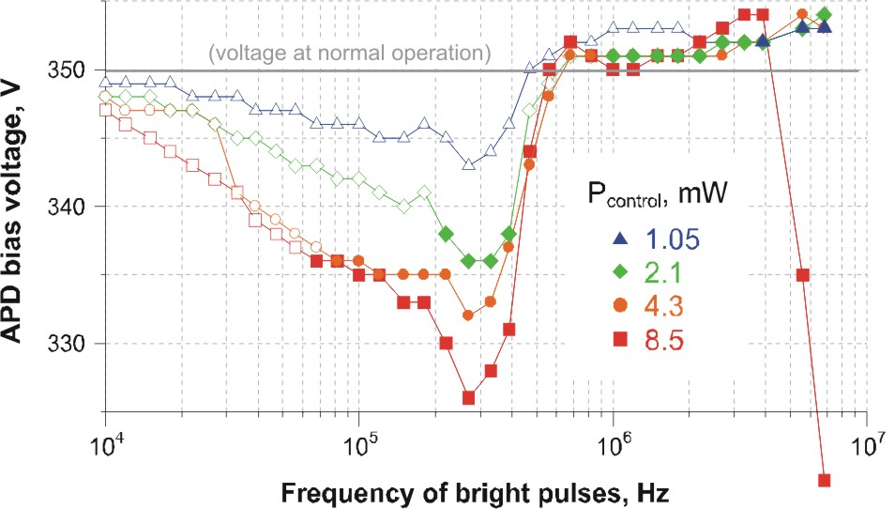
A bit of pulse light...
34
Voltage at the APD lowered well below breakdown
Breakdown voltage raised up due to heating of APD chip?

Slide 35
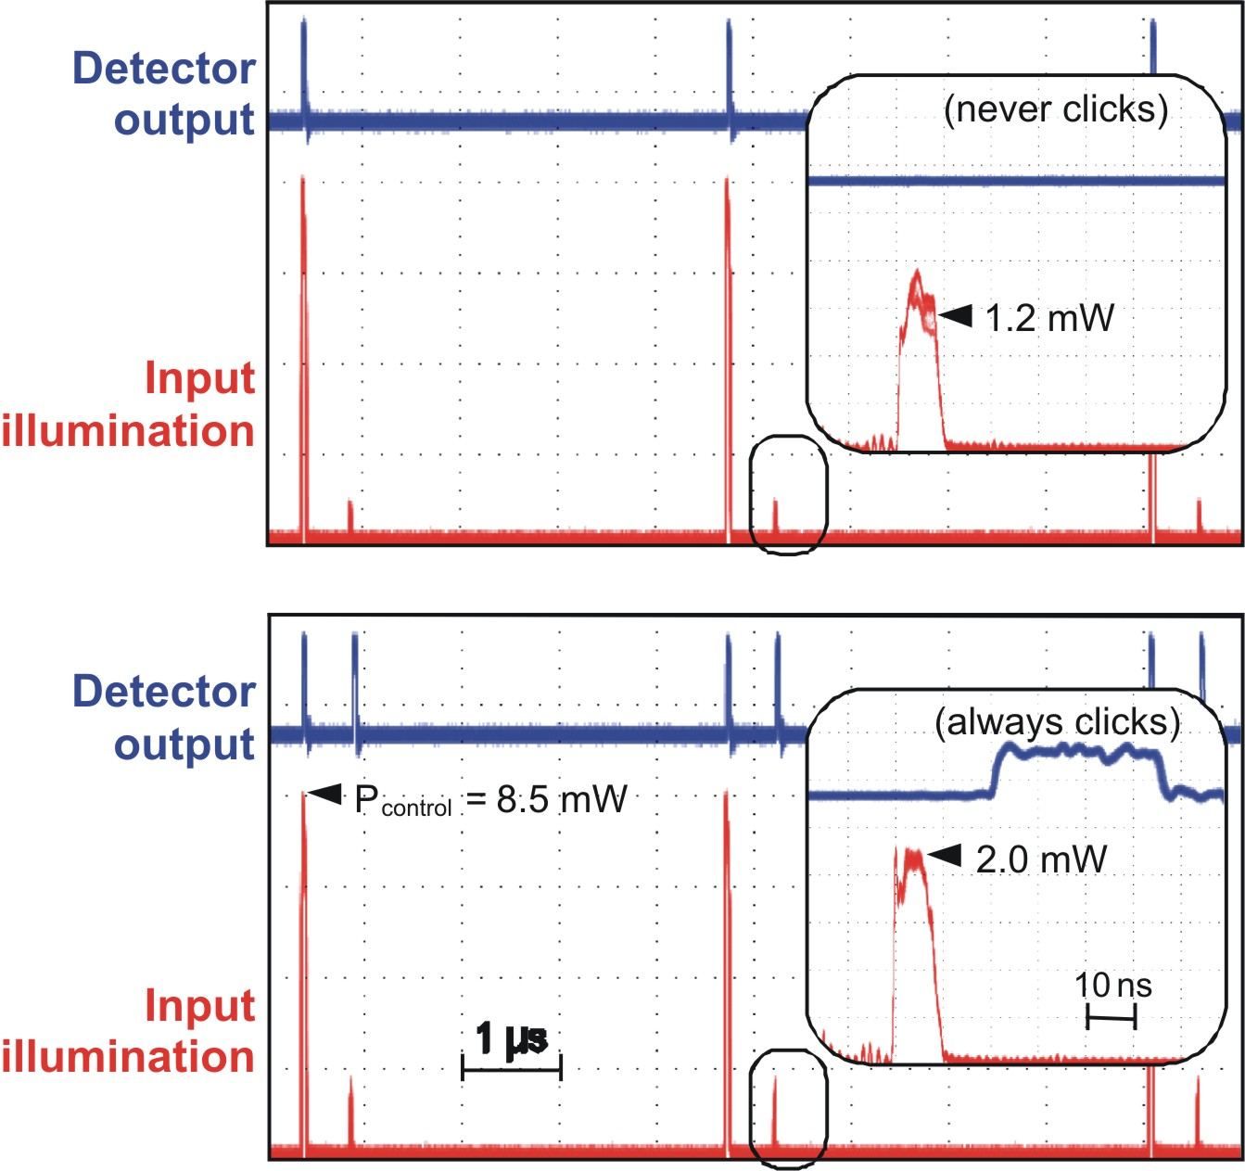
Et... voilà !
35
Control pulse blinds detector
Weaker trigger pulse makes the detector click controllably
with unity probability and sub-nanosecond time jitter
above an intensity threshold

Slide 36
The return of the faked-state generator (How we break them all)
36
Eve forces her detection result onto Bob by sending
- CW or pulse light to keep all detectors blinded (circular polarization)
- Faked-state above threshold I₀ to make target detector click (linear polarization)
Pulsed? C.W.?
Control generator (blinding)
Faked state generator
In conjugate basis, faked-state is split in half, below threshold (no click)

Slide 37
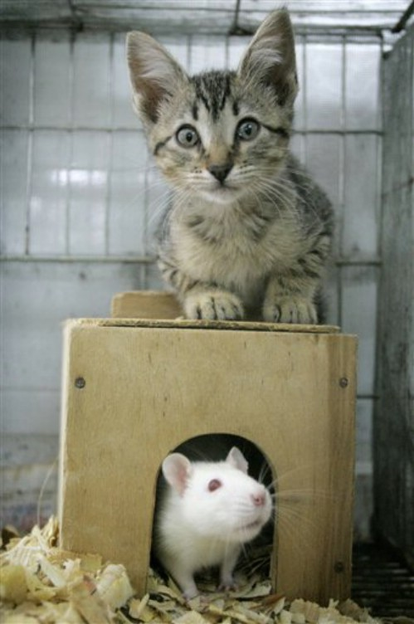
Is QKD practically secure?
37
YES, if you built it right!
Cat
NO because you can only “build it” to within certain tolerances (some with unknown potential problems)
Mouse
Remember: you don’t need to break the laws of physics to break QKD...
www.iet.ntnu.no/groups/optics/qcr

